Slide 1
Overview of illegal memory modifications – Attacks and Defenses
Dennis Fischer
07.12.2015

Slide 2
What is Process Memory Tampering (PMT) ? (1)
„Illegal modification of a process virtual memory by a malicious program“

Slide 3
Virtual memory
Every process uses it‘s own address space
1 part is used for the code sections
Can be allocated (malloc)
Can be modified from
Inside
Outside

Slide 4
What is Process Memory Tampering? (2)
Attacker can directly modify virtual memory
Examples:
Intercept/Redirect function calls
Change values
Read (secret) information (SSL Shared keys, Userdata,…)
2 general ways to get access on virtual memory:
Attack from inside
Attack from outside

Slide 5
Where is PMT being used?
„Attacks“ on virtual memory are very common!
Every online games faces the problems of cheaters/bots
Cheats directly modify the virtual memory
Very advanced and game specific
Common online cheats:
Aimbots
Wallhacks
„Scripts“
Hijacking of applications (for example browsers)
Antivirus software

Slide 6
Outside Attacks (1)
Usermode or Kernelmode attacks (Detectability)
Most use WriteProcessMemory
Directly write into virtual memory
Typically always possible (Debug function)
DLL Injection
Many ways (SetWindowsHookEx, Registry, DLL Replacement, …)
Currently only any identified by antivirus with hashvalue

Slide 7
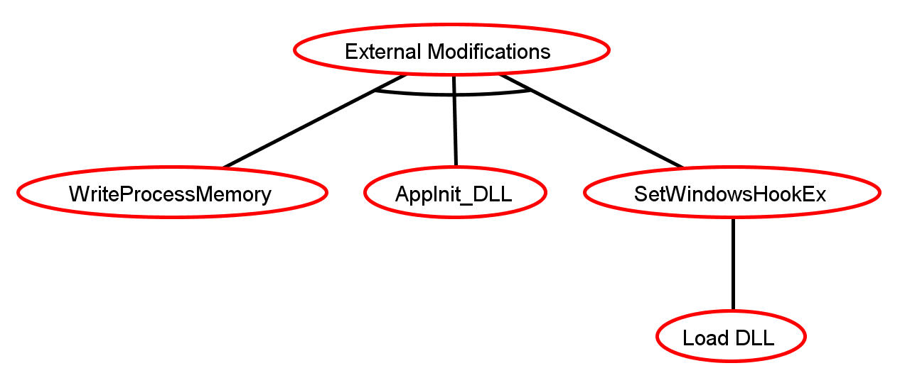
Outside Attacks (2)

Slide 8
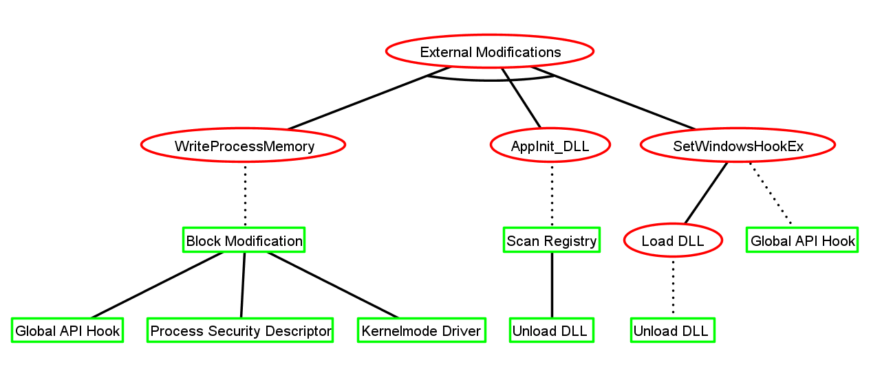
Outside Attacks – Defense Ideas

Slide 9
Inside Attacks (1)
For some reason the attacker is already inside the process virtual memory:
DLL Injection
Code Cave
Already attacked from outside
Modifications now easily possible:
memcpy
memset
…

Slide 10
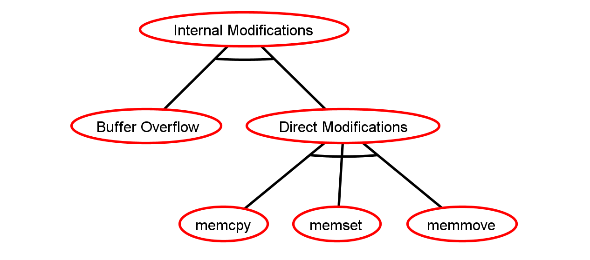
Inside Attacks (2)

Slide 11
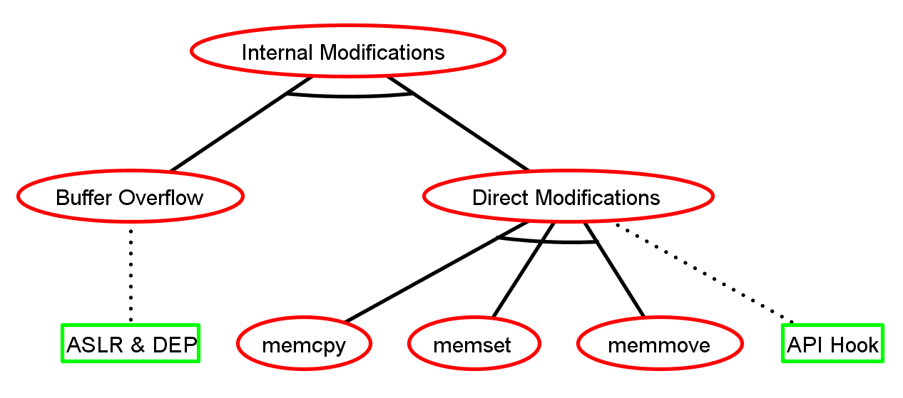
Inside Attacks – Defense Ideas

Slide 12
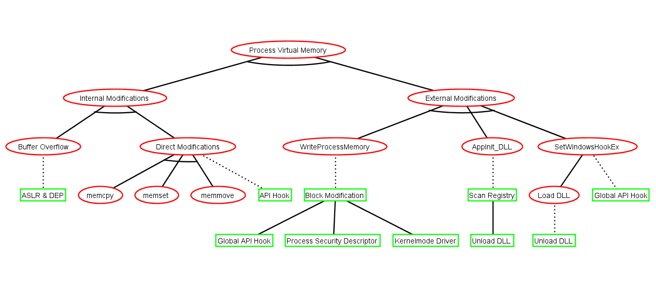
Putting it together

Slide 13
What of these defenses are currently existing?
Basically nothing! Why?
Existing techniques like MIC, DEP and ASLR don‘t help (See next slides)
Kernelmode attacks cannot be blocked!
Only few researches done in this area.
Commercial solutions are closed source (e.g. Anti-Cheats, Antivirus)

Slide 14
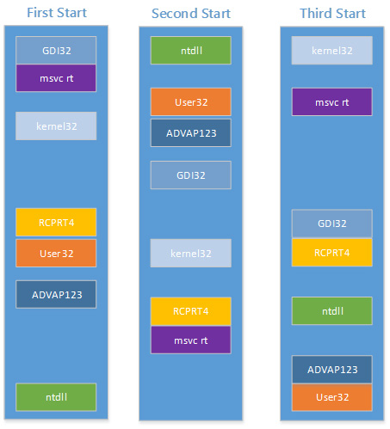
Address Space Layout Randomization (ASLR)
Randomize location of heap, stack, PEB, TEB,
Attacker has to guess memory locations
Memory space is huge, thus searching is hard
Wrong guess → Application crashes
BUT:
Does not prevent PMT
Windows 7 ASLR very ineffective
Attacker has enough time to search
API Hooking requires no search
https://technet.microsoft.com/en-us/library/dn283963.aspx

Slide 15
Data Execution Prevention (DEP)
Some memory pages are set to „No execute“ (NX bit)
Executing code from NX marked page → Application crashes
BUT:
Windows 7 doesn‘t require processor with DEP support
Every process contains at least one page without set NX bit → Inject code into code region, mark data region as executable
Unset NX bit with VirtualProtectEx

Slide 16
Mandatory Integrity Control (MIC)
Based on Multilevel Security and Bell-LaPadula model
Every object has an assigned integrity level
Objects cannot modify higher leveled objects
BUT:
Most processes run with Standard(Medium) integrity level → No protection from memory modification
Raising integrity level of Chrome to high is bad → Better protection than medium integrity level
Integrity Levels
System
High
Medium
Low

Slide 17
Thesis Goal (1)
Find a way to detect illegal virtual memory modifications inside Google Chrome
If possible, prevent modifications / hijacking
Limit to Usermode (See next slides)
Windows 7

Slide 18
Thesis Goal (2)
Find a way to detect illegal virtual memory modifications inside Google Chrome
If possible, prevent modifications / hijacking
Limit to Usermode (See next slides)
Windows 7
Challenges:
Attacks from inside and outside possible
Detection proves to be difficult
Almost no existing researches
Some defenses currently just ideas and part of further research in the thesis „Detecting Process Memory Tampering“

Slide 19
Why focus on Windows 7 and Google Chrome?
Windows 7 has a total market share of ~50% ¹
Windows 8, 8.1 and 10 have only a combined one of ~30% ¹
Google Chrome has total market share of ~66%¹
Browser Hijackers are a big problem – some of them use PMT

